Slide 1

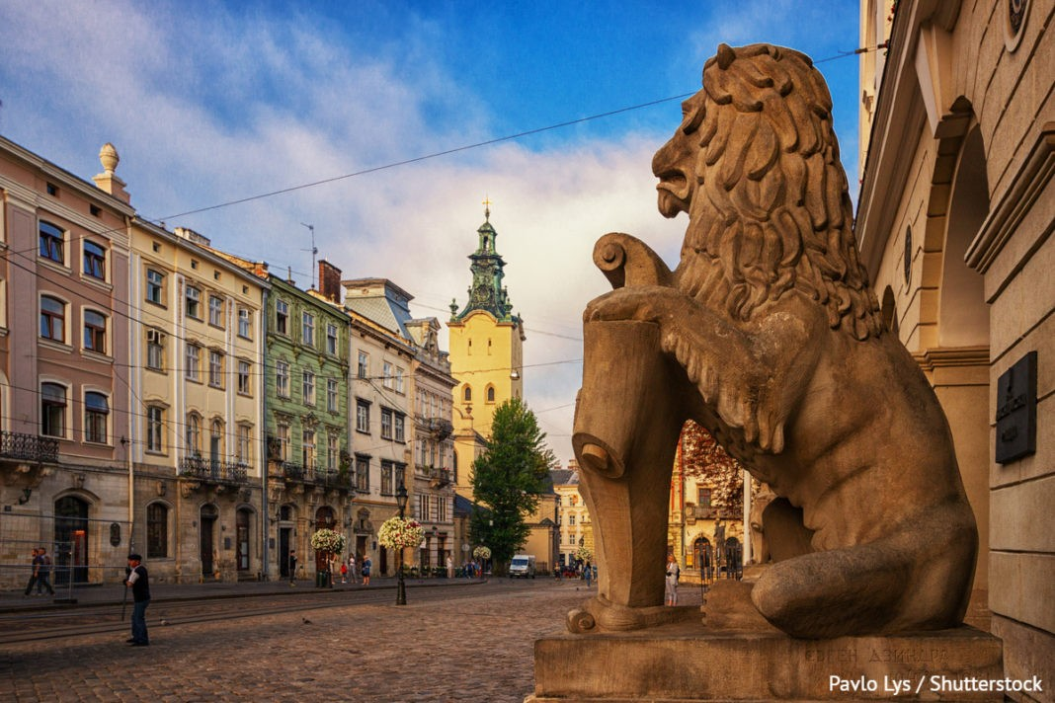
INVEST
in West Ukraine
2025

Slide 2

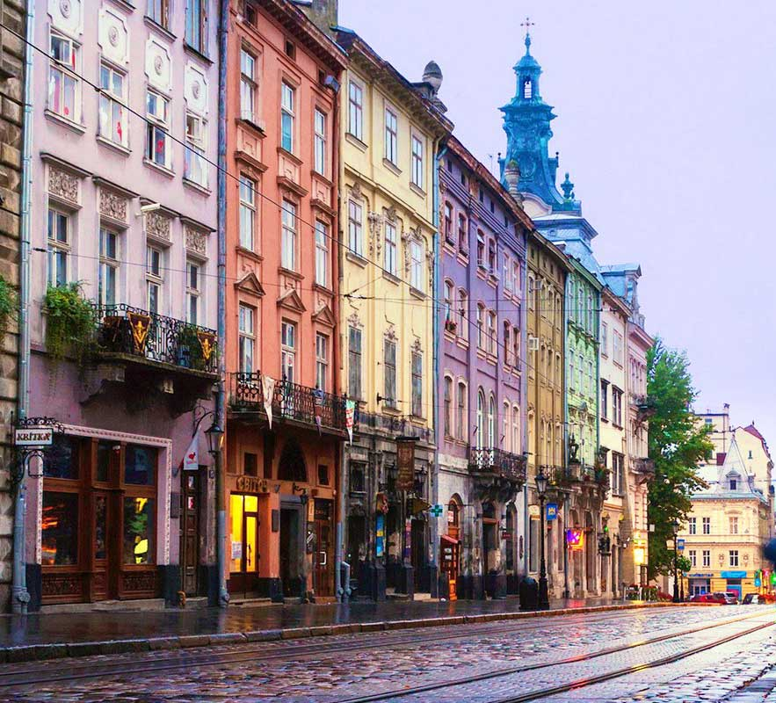

Introduction
In recent years, Ukraine has passed the most difficult times of formation and taken a swift course towards the introduction of European and global standards, which has opened up a new variety of opportunities for foreign investors.
I was born here and lived here throughout my life, and now I notice how fast everything changes towards facilitating doing business in Ukraine.
That is why we appeal to you: it is high time to implement your business plans in Ukraine!
We are ready for any projects, and we are sure that together we will bring them to life successfully.
MARKIAN MALSKYY,
Managing Partner and Head of the West-Ukrainian Branch at Arzinger Law Office, Honorary Consul of Austria in Lviv

Slide 3
Lviv was…
Founded in 1256 by King Daniel of Galicia and named after his son Lev (meaning “lion”)
One of the first cities that obtained the Magdeburg Right
Compared to Italian Piedmont, as it also was springboard for national rise and unification
Under the rule of Poland, the Austro-Hungarian Empire, and the Soviet Union. This had an undeniable impact on the demographic and economic situation as well as the level of civic consciousness of the population

Slide 4
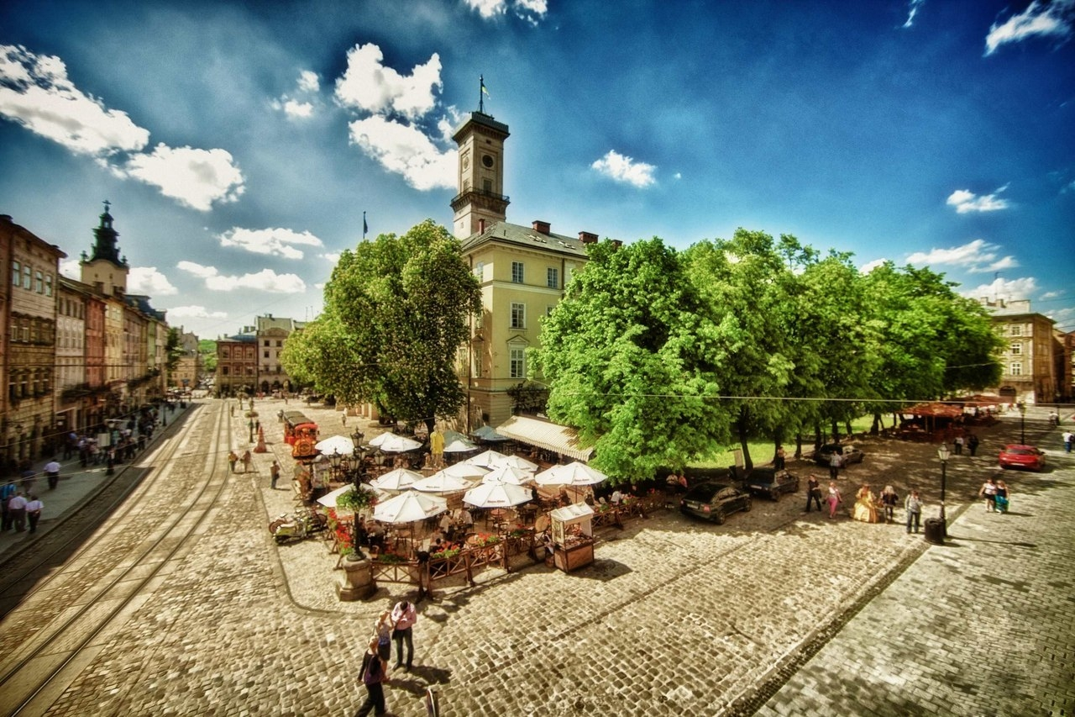
Lviv is…
Fast-growing and developing modern city with a historical background. Central part of the city constitutes a historical and architectural reserve and is included in the UNESCO List of World Cultural Heritage
Go-to destination for tourism and business
On the crossroads of Western and Eastern Europe
Widely regarded as Ukraine’s European business card
City of youth and education. 16% of the population are students, and this number is growing every year

Slide 5
Numbers and Facts
Lviv is the largest city in western Ukraine
Over 2,5 million population
of the Lviv region
Lviv was named the Youth
Capital of Europe 2025
Lviv got the EBRD Sustainability Awards 2020
Ranked in the Financial Times fDi Intelligence Global Top 10
“Smart Locations of the Future”
for cost-effectiveness
Lviv International Airport is the largest airport in Western Ukraine, based on passenger flow and destination network.
(The airspace of Ukraine is closed to civilian aircraft as of now)

Slide 6
Geographic location
The main roads that run through Lviv region
Lviv to Kyiv – 555 km
Lviv to Odesa (seaport) – 804.5 km
Lviv to Warsaw (Poland) – 390.5 km
Lviv to Krakow (Poland) – 325.6 km
Western Ukraine is located on the crossroads of multiple trade routes providing access to multi-million consumer Markets
Lviv – Berlin — 925 km
Lviv – Warsaw — 381 km
Lviv – Chisinau — 477 km
Lviv – Kyiv — 542 km
Lviv – Budapest — 574 km
Lviv – Bucharest — 607 km
Lviv – Vilnius — 769 km
Lviv – Bratislava — 775 km
Lviv – Vienna — 824 km
Lviv – Prague — 843 km
Lviv – Athens — 1851 km
Lviv – Istanbul — 1504 km
M-06 – Kyiv-Chop (Hungary)
288.7 km
М-09 – Ternopil – Lviv – Rava Ruska(Poland)
136.2 km
М-10 – Lviv – Krakivets (Poland)
85.7 km
М-11 – Lviv – Shehyni (Poland)
76.9 km
M-30 – Stryi – Uman – Dnipro – Izvaryne
44.3 km

Slide 7
WHY
to invest

Slide 8
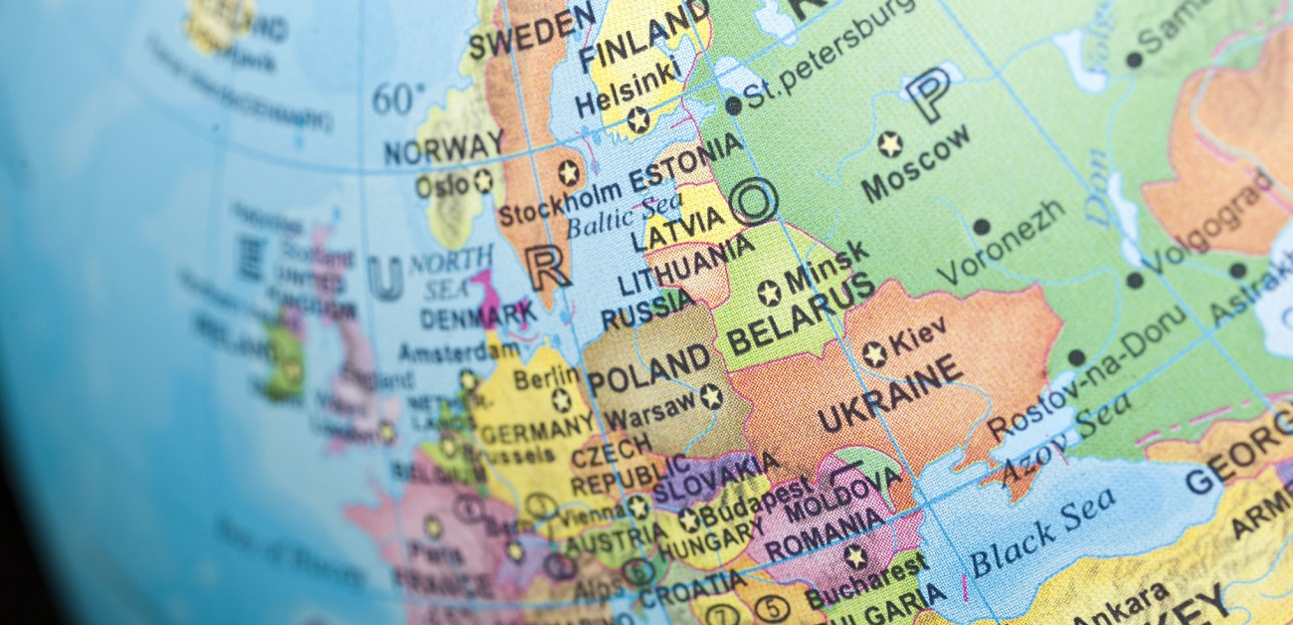



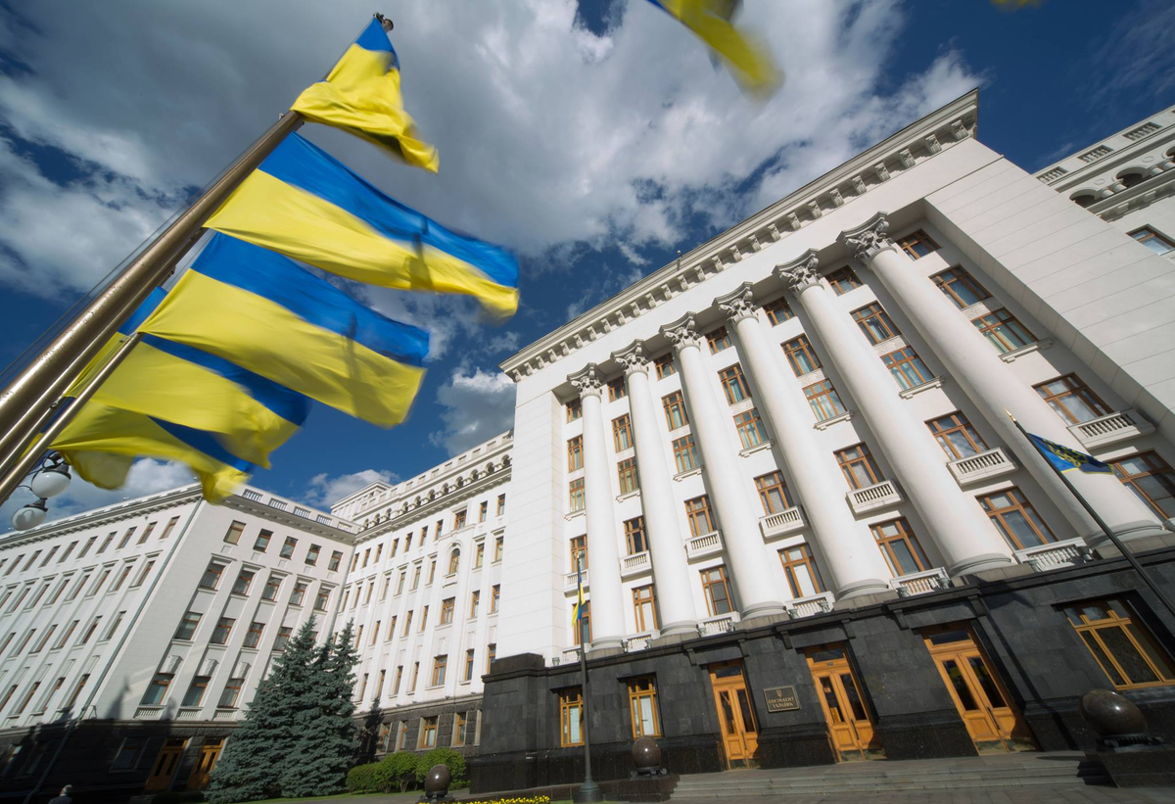
Main reasons to invest
Geography
Infrastructure
Human Resources
geographical location, logistics
free trade association
availability of raw materials & land
developed infrastructure
main trade routes & international airport
competitive prices for real estate
available labour resources
competitive salaries
competitive tax rates
Business Approach
Government Support
easy business incorporation & administration
non-occupied internal market niches
possibility to operate on the tolling system
pro investment approach of local authorities
readiness to support business representatives in complicated transactions

Slide 9
Relocated business to West Ukraine
Since the beginning of russia's full-scale invasion of Ukraine, 966 businesses have been relocated to the Lviv region.
Category of relocated business
Light industry
Machine building
Metalworking
Food industry
Chemical industry
Agribusiness

Slide 10
Labour potential
Total population of the 8 regions (oblast’) of western Ukraine is around 9.1 million people
The largest cities of the region are:
Lviv – 757.5 thousand residents
(over 1 million including suburban area);
Khmelnytskyy – 273 thousand
Chernivtsi –267 thousand
Rivne – 246 thousand
Ivano-Frankivsk –237 thousand
Ternopil – 223 thousand
Lutsk – 217 thousand
Uzhgorod – 115 thousand
Mukachevo – 85 thousand
Drogobych – 75 thousand
The Lviv region has a population of more than 2.5 million people.
The majority (60%) reside in urban areas.

Slide 11
Employees distribution by industries

Slide 12
Taxes on the salary
Employee’s taxes, which have to be deducted from the salary (by an employer as a tax agent) amount to 23%, which includes:
Employer’s taxes – 22%
of unified social contribution (USC), which is calculated from the salary gross.
Personal income tax –
18%
Military contribution –
5%
EXAMPLE
Costs of the Employer on the Salary Gross in the amount of 500 EUR
 | Salary Net, EUR | Personal income tax, EUR | Military contribution, EUR | USC, EUR
Costs of the Employer | 402,5 | 90 | 25 | 110

Slide 13
Landowners in Ukraine
PUBLIC OWNERS
PRIVATE OWNERS
State
Municipality
Individuals
Ukrainian and foreign legal entities

Slide 14
Acquisition of freehold/leasehold
FREEHOLD
LEASEHOLD
Foreign companies
Ukrainian companies (owned 100% by Ukrainian entity)
No limitations
for any subject
Acquisition of public land is subject to government’s/parliament’s approval
No limitations
Anywhere – if they acquire real estate, or in urban areas – for property construction
N.b. Due to inconsistency in the land legislation, there is no clear position on whether Ukrainian companies that are 100% directly owned by a foreign shareholder are eligible to own land in Ukraine. Therefore, we recommend avoiding this structure in land acquisition deals.
Only non-agricultural land

Slide 15
Export
What is exported
Machinery, equipment and mechanisms, electrical equipment
Industrial products
Products of vegetable origin
Textiles
Wood and wood products
Food products
Fats and oils of plant or animal origin

Slide 16
Import
What is imported:
Machinery, equipment and mechanisms, electrical equipment
Textiles
Mineral products
Polymer materials, plastics and plastic products
Non-precious metals
Food products
Products of vegetable origin
Chemical products and related industries products

Slide 17
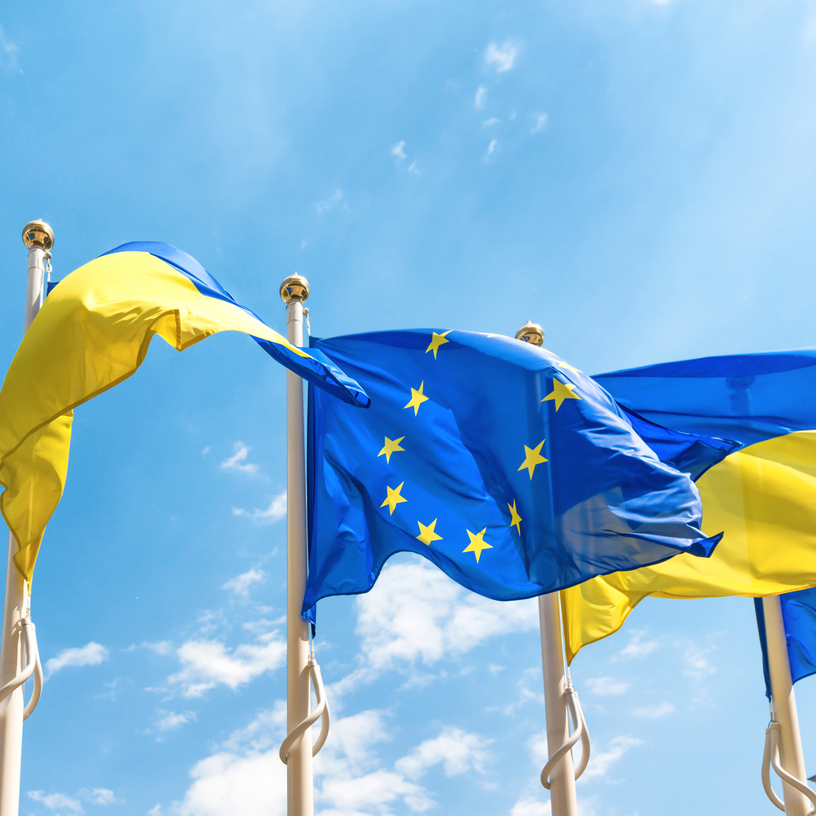
European integration
EU-Ukraine Association Agreement. On 27 June 2014, the EU-Ukraine Association Agreement was signed by the Heads of European Union States and Governments and the President of Ukraine.
DCFTA. The EU and Ukraine have provisionally applied their Deep and Comprehensive Free Trade Agreement (DCFTA) since 1 January 2016. This agreement means both sides will mutually open their markets for goods and services based on predictable and enforceable trade rules. Annexe I-A to the DCFTA provides schedules for the reduction of import duty rates by the parties to the Agreement. For the large number of goods, import duty rates are lowered immediately to 0% starting from 1 January 2016.
On 28th February 2022, Ukraine applied for EU membership.
On 23rd June 2022, the EU granted Ukraine candidate status along with 7 recommendations. Their implementation is a prerequisite for the EU's decision to open membership negotiations with Ukraine.
Ukraine is now on its way to the European Union.

Slide 18
Import duty
Import duties and taxes are due when importing goods into Ukraine by a private individual or a commercial entity.
These are calculated on the CIF value, i.e. the sum of the value of the imported goods and the cost of shipping and insurance.
In addition to duty, imports are subject to Sales Tax and Excise Duty.
Duty Rates.
Ukraine applies duties at rates between 0% and 60%, with usual rate of 15%.
Sales Tax.
Imports into Ukraine are subject to a standard VAT rate of 20%, levied on the sum of the CIF value, duty, and excise duty if applicable. Some goods are subject to a reduced rate of 7%.
Other taxes and customs fees.
Excise Duty applies to products like alcohol and tobacco.

Slide 19
Starting business
The most common forms of starting business activity in Ukraine are:
Registration
of private entrepreneur
Establishing a legal entity
Representative office
LEGAL FORMS
OF COMPANIES
Limited liability company
Partnership in commendam
Additional liability company
General partnership
Joint stock company

Slide 20

Establishing of LLC
The most practical legal form of business entity is Limited Liability Company (“LLC”)
Registration actions usually take 4-5 working days (after all the documents are prepared).
LLC acts on the basis of the Charter, in which all the major issues of the activity and bodies of the LLC are prescribed.
Shareholders of LLC may be residents and non-residents of Ukraine, individuals or legal entities.
Executive Body of LLC may be formed via the appointment of a sole Director or a Board of Directors.
As for the date of state registration, the LLC has to indicate the official place of registration of the LLC.
There is no specified amount of minimal charter capital. Declared charter capital has to be paid within six months from the date of the LLC’s registration unless otherwise specified by the Charter.
The information about Ultimate Beneficiary Owners (“UBO”)* has to be obligatorily indicated in the state register.
* The UBO is defined as the individual who has the direct or indirect possession of 25% or more of votes in the company.

Slide 21
Corporate governance
Shareholders Meeting
The highest body of LLC
All crucial decisions are taken via shareholders’ meeting
Controlling body
of the Company
(Supervisory Board)
Supervisory Board is actually an intermediate between the shareholders’ meeting and the management body:
it controls the activity of the management body.
Part of the authorities of the shareholders’ meeting (except their exclusive competence) may be delegated to the Supervisory Board. Establishment of the Supervisory Board is not obligatory.
Management of the Company may be sole Director or Board of Directors
Director (-s) conduct comprehensive management of everyday activity of the Company. The law provides legal tools to limit powers of Director (-s)
The law provides legal tools to limit powers of Director (-s), i.e. limitations on the sums which may be operated by the Director without any authorization from shareholders or to prescribe the required authorization to be obtained by the Director prior to conducting of special types of deeds (lease, sell and purchase agreements of property, mortgage, etc.)

Slide 22

Tax
GENERAL OVERVIEW OF TAXES IN UKRAINE |  | RATE
Corporate income tax |  | The headline rate – 18% (0, 3, 9, 10, 18, 25, 30% - applicable to certain companies / business activities)
VAT / GST |  | The headline rate – 20% (0, 7, 14 % - applicable to certain transactions)
Withholding Tax | Dividends | 15% (5% / 10%)
 | Interest | 15% (2 % / 5% / 10%)
 | Royalty | 15% (5% / 10%)
 | Other income | 0% – 20%
Personal Income Tax |  | 18% (0, 5, 9% – applicable to specific items of income)
Military Levy |  | 5%
Real estate tax |  | ≤1,5% of the min wage / 1sq. m.
Land tax/Land rent |  | 0.1% - 12%*
Privileged income tax regime |  | This regime offers tax savings for agricultural companies and private individuals doing business without incorporation of separate legal entity, by registering as private entrepreneur.
New Developments
Transfer pricing (since 2013)
VAT electronic administration system (since 2015)
Multilateral Convention to Implement Tax-Treaty-Related Measures to Prevent BEPS (MLI) (Since 2019)
FATCA (Since 2020)
Controlled Foreign Companies (CFC) (since 2022)
Diia City (since 2022)
Automatic Exchange of Information (CRS) (since 2024)
DAC-7 / DAC-8 (expected since 2026)
* - is calculated from the normative monetary value.

Slide 23
Improvement of investment climate
Legislative changes:
The following bodies aimed
to support investors were established recently:
Anti-corruption reform, creation of National Anti-Corruption Bureau of Ukraine;
Judicial reform, reform in judgments enforcement;
Strengthening of anti-raider legislation;
Decentralization of powers to the registration;
Amendments of legislation on corporate governance, introduction of the shareholders agreements;
Simplifying the procedure of obtaining of work permits and temporary residence permits for foreign citizens;
Liberalization of foreign currency control by National Bank of Ukraine.
Board of exporters and investors of Ukraine under the Ministry of Foreign Affairs of Ukraine;
National Investment Council;
Consulting and advisory bodies to promote pre-trial settlement of disputes between investors and executive authorities (local government);
Investment departments of cities’ and regional councils.

Slide 24

Government support for investment
Diia.City - a virtual free economic zone for tech companies in Ukraine.
Public-private partnership (PPP) in Ukraine is a form of cooperation between the state and the private sector aimed at implementing infrastructure and social projects. PPPs can be implemented in various forms, such as concessions, joint venture agreements, and other contracts.
Main benefits for residents:
Low Taxes Rate
Investment promotion
Different employment
models
Venture investment tools
IP Protection Guarantees
Fixed conditions for 25 years
In 2023, amendments to the Law “On State Support for Investment Projects with Significant Investments in Ukraine” were signed.
It provides for the provision of state support to investors in the form of tax benefits, preferential land use, infrastructure financing, and individual support for investment projects by the state institution UkraineInvest.
Ukraine is actively developing industrial parks, which are a priority for attracting investment in the real sector of the economy and supporting the “Made in Ukraine” policy.
As of January 2025, the number of industrial parks has increased to 100. 40 of them are located in Western Ukraine: 15 in the Lviv region, 6 in Zakarpatia, 4 – Ivano-Frankivsk and Khmelnytsky, 3 – in Ternopil, Chernivtsi and Rivne, 2 – Volynska (Lutsk).

Slide 25
What to invest in
Spheres and industries of investment
Retail and Wholesale
Pharmaceuticals
and Healthcare
Tourism and Leisure
Infrastructure
Real Estate
Agriculture
Energy
IT/BPO

Slide 26
Investments by countries

Slide 27
Investments by spheres

Slide 28
Successful investment stories

Slide 29
OVERVIEW
of the main industries of investments

Slide 30

Business relocation trend
In recent years, we are witnessing a tendency when the biggest successful foreign companies are relocating their production to Ukraine.
In the last years, a significant number of large and medium foreign investors from Poland, Romania, Belgium, Germany, France, Turkey, etc. started their business activity in Lviv and the Lviv Region.
The main reasons are taxes, salary rates, geographic location and other local conditions that make the Lviv region attractive for investments.
This means the following: the first ones will receive the highest benefit from the investment in Ukraine!

Slide 31
Relocation of production as an “option”
Main spheres of production relocation
Automotive
Machinery
Light Industry
Food and Beverages
Main reason of production relocation
Possibility to operate with
tolling materials
Possibility to hire educated
cost-effective staff
Tax rates

Slide 32
Sold industrial products by industry

Slide 33

Business processes outsourcing
Why business outsource is a good decision:
The outsourcing market in Lviv has been showing steady growth since 2002. This means that partners in Ukraine are maturing and delivering services, and more and more clients are becoming inclined on taking a chance on Lviv.
The key now is to take advantage of the opportunities presented by Lviv as a regional outsourcing powerhouse.
Investors provide outsourcing offices only with the standardized schemes of work;
Availability of well-educated English/German/Polish and other languages speaking staff to be employed on the outsource;
There is no direct necessity to purchase or to lease real estate for the purposes of outsourcing (unless investor has such intention). In case there is an intention and/or necessity in real estate objects purchase or leasing, there is a list of options to choose the most optimal for you in Lviv Region.
Representative experience, among others have such companies as Nestle, Veon, Austrian Airlines, PWC and other. Additionally, a lot of call-centers work on the BPO basis in Lviv Region.

Slide 34
Sectors to invest
Agriculture
Agricultural complex of Lviv region consists of wide range of agri segments such as:
grain production
sugar beet planting
processing of fruits
and vegetables
meat industry
milk industry
poultry industry
Still, such does not use its full capacity without sufficient technology.

Slide 35
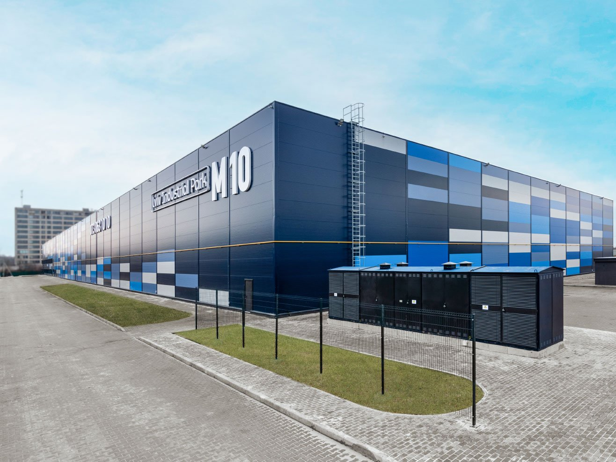
Sectors to invest
Real estate & Infrastructure
Lviv region potential:
Industrial parks
Business centers
Hotels and Hostels
Logistic Warehouses
Shopping and entertainment centers

Slide 36
Sectors to invest
Energy
SOLAR ENERGY
85 solar power plants with a total capacity of 354, 575 MW
SOLAR POWER PLANTS IN WESTERN UKRAINE:
Ozerna (9,9 MW). Commissioned in March 2017;
Sambir-1 (3,1 MW) – 2012;
Sambir-2 (5 MW) – 2017;
Bogorodchany (2,8 MW) – 2013;
Gelios Energy (4 MW) – 2013;
Yavoriv (72 MW) – 2018 and 2019;
Soniachne pole (2MW) – 2018;
Ternovytsya (104MW) – 2018;
Boryslav (8,5 MW) – 2019;
Hlyniany (3,5 MW) – 2019;
Hlyniany-2 (17,95 MW) – 2019 ;
Radekhiv (8,45 MW) – 2019.
WIND ENERGY
4 wind power plants with a total capacity of 88,5 MW
ACTIVE:
Sokal wind park (45,2 MW) (by Eco-Optima) (2024);
Skole (60,2 MW) (by Atlas Global Energy) (2021) ;
Skole (54,6 MW) (by Eco-Optima).
ALREADY COMMISSIONED / OPERATING WIND POWER PLANTS IN WESTERN REGION:
Staryi Sambir-1 (20,7 MW);
Staryi Sambir- 2 (13,2 MW);
Smerechanska WES (37,95 MW);
Carpathian WES (51,75 MW).
Sokal wind park (45,2 MW) (by Eco-Optima) (2024);

Slide 37
Sectors to invest
IT sector
IT in nutshell:
Largest companies:
R&D in Lviv:
Lviv has taken the second place among 22 in the ranking of cities most comfortable for IT;
53 000+ professionals work in IT in Lviv;
511 IT companies are located in Lviv;
$ 45,54 mln the volume of taxes paid by IT companies in the region for the first half of the 2024;
one IT specialist creates 3 jobs in Lviv;
4 000+ IT graduates annually;
90% – work in outsourcing*.
SoftServe
EPAM
ELEKS
GlobalLogic
N-iX
Intellias
Avenga Zone3000
Siemens
Ericsson
Ajax System
Wirex
SoftServe
*The vast majority of customers in the IT sector are foreign companies

Slide 38
Sectors to invest
Pharmaceuticals and Healthcare
Pharmaceutical industry is traditionally one of the main industry sectors in the economy of Ukraine and most dynamic. It covers production of pharmaceuticals and medical purpose articles, wholesale and retail trade, specialized storage and distribution through developed sales network.
Commodity supply chain of the pharmaceutical industry in the country includes foreign companies (imported products), local manufacturers, wholesalers/distributors of pharma related products, public and private hospitals and the retail segment.
The most famous representatives of the local market are Medicover
(chain of private clinics), Synevo (chain of private laboratories) and
Arterium (producer of drugs and pills).

Slide 39


Sectors to invest
Pharmaceuticals
Healthcare
Potential spheres to develop your business in:
Laboratories: in recent years improvement in the sector of private laboratories may be observed. Though these laboratories were opened by local business representatives as for now.
Potential spheres to develop your business in:
Private clinics: there is a huge perspective in this field as private clinics are on the very beginning of their development and there is no great variety of them on the market yet.
Also, Lviv region, as well as all Western region, has significant potential of growing sales of medicines and other pharmaceutical products due to the large number of educational medical institutions and hospitals.

Slide 40
Sectors to invest
Tourism
Approx. 2,5 million of tourists visit Lviv
every year
Over 200 hotels and other accommodation facilities in Lviv region
About 33 000 bed places in hotels and other accommodation facilities
More than 1 000 cafes, restaurants, bistros and other food establishments
Over 4 thousand of historical and architectural relics of 12-20th century in
Lviv region (25% of all objects in Ukraine)
Source: http://dashboard.city-adm.lviv.ua/statystyka/turyzm

Slide 41
Sectors to invest Tourism
…come to Lviv from…
Poland
Turkey
Germany
Great Britain
USA
Lithuania
Israel
Canada
France
Other

Slide 42
Sectors to invest Tourism
… stay in city in average
for 3,8 days
…spend in average
94€ per day
…for the fist time in Lviv –
52%
…revisit the city –
48%
…come to Lviv by…
Bus
11,6%
Car
11,8%
Plane
30,8%
Train
45,8%
…stay in Lviv in…
Hotel – 29,5%
Apartment – 30,1%
Hostel – 31,0%

Slide 43
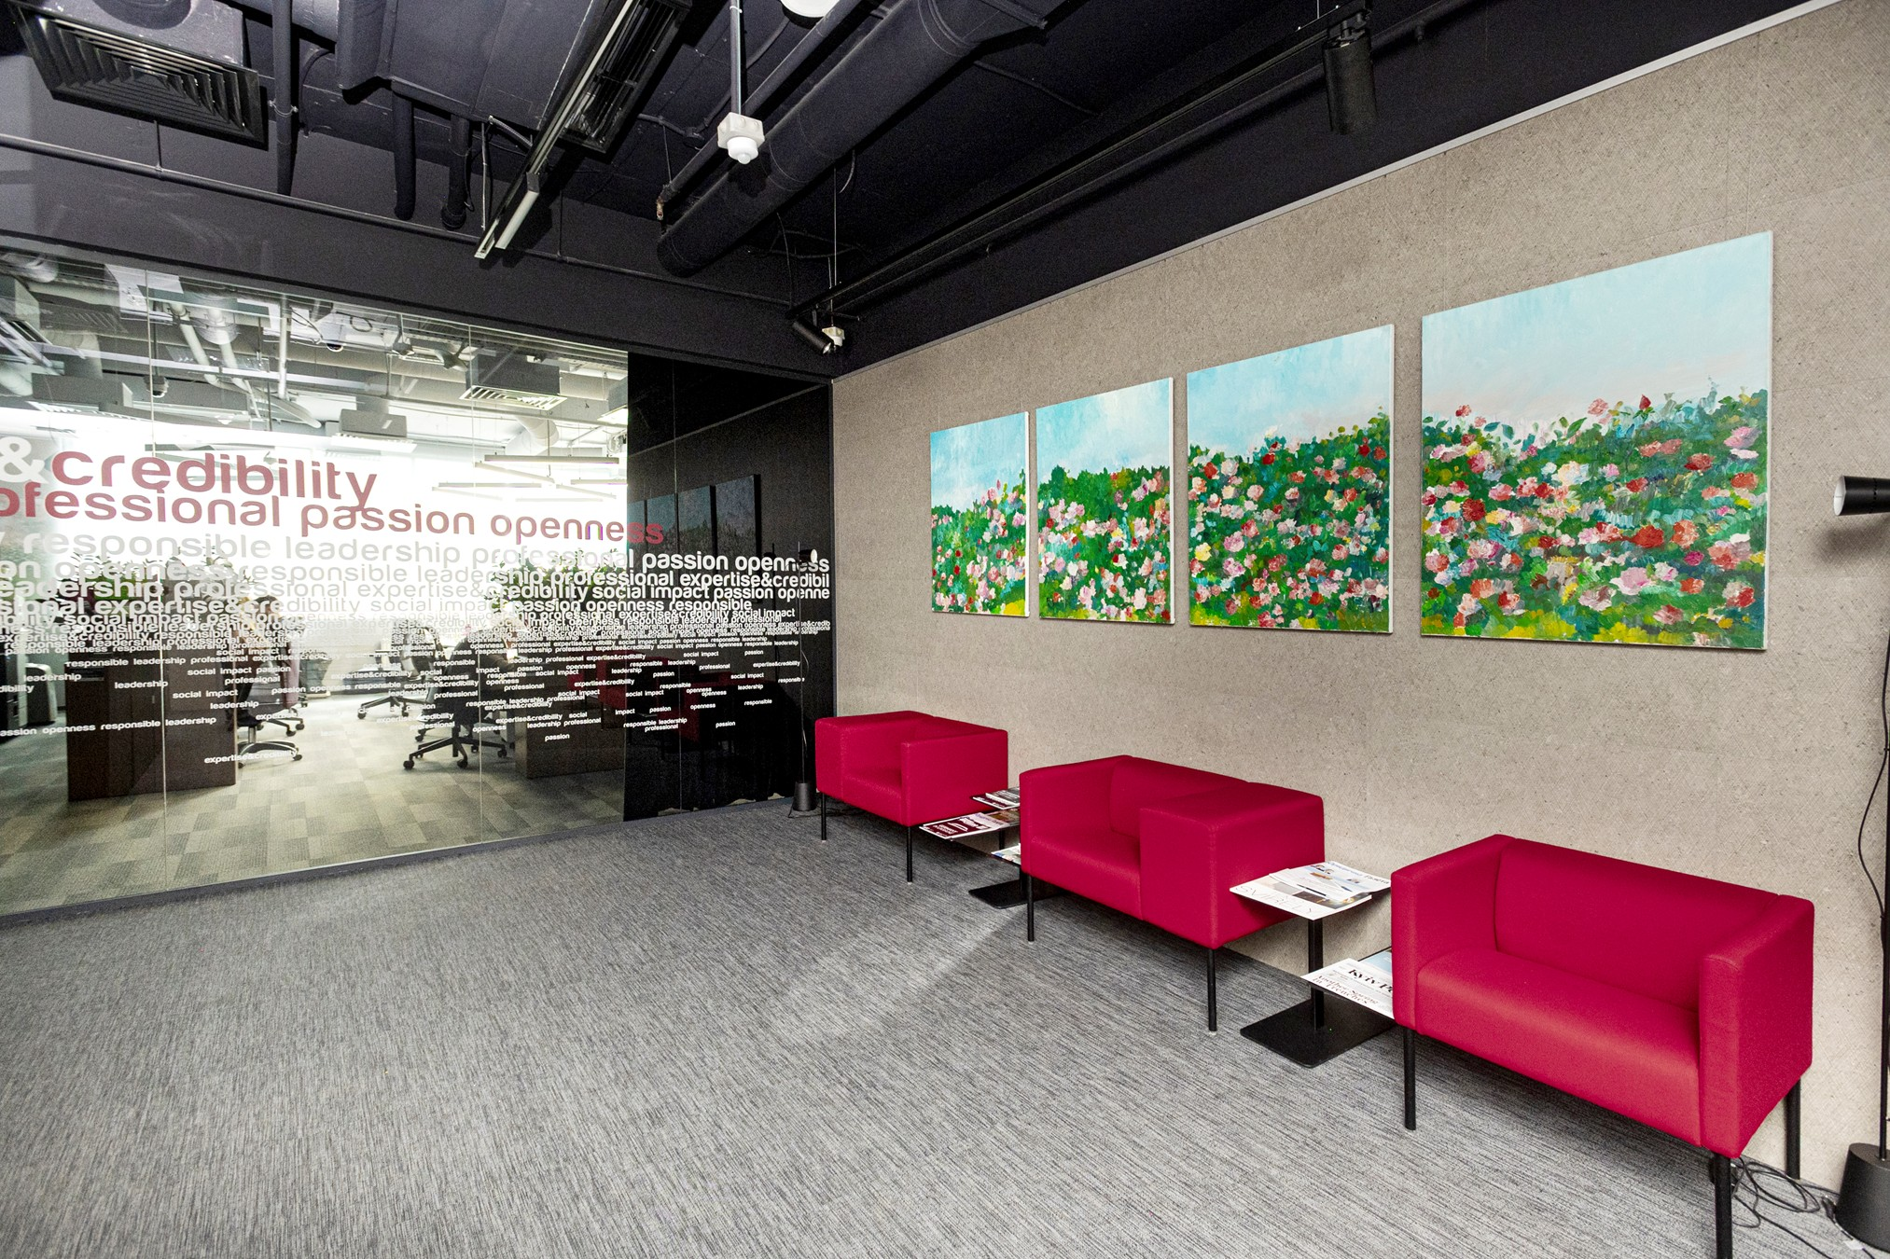
Where
the law
rules

Slide 44

ARZINGER in a glance
20+
Years in the Ukrainian legal services market
GERMAN
DESK
Kyiv
12
Partners
Lviv
70+
Odesa
Associates
Partners in more than 150 jurisdictions worldwide
Ukrainian leading law firm
Recognised in rankings:

Slide 45






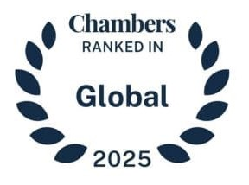



Awards
Chambers Europe
IFLR 1000
Best Lawyers
2013-2025
2014, 2017-2020
2019-2021
Corporate/M&A
Corporate/M&A
Kateryna Gupalo
Intellectual Property
Banking & Finance
Lana Sinichkina
Dispute Resolution
Project Development
Timur Bondaryev
Labour
Real Estate & Construction
Sergii Shkliar
Antitrust & Competition
Oleksander Plotnikov
Banking &Finance
WWL
Kateryna Oliinyk
2018-2020, 2022
Taras Kyslyy
Competition
Oleksander Dyakulych
Corporate/M&A
Business Crime Defence
The Legal 500
Life Sciences
2018-2025
Real Estate & Construction
Chambers Global
Banking & Finance
Real Estate & Construction
2013-2025
Private Clients
Commercial, Corporate & M&A
Corporate/M&A
Competition
Dispute Resolution
GRR 100
Banking & Finance
Dispute Resolution
2022-2024
White-Collar Crime
  Restructuring & Insolvency
Employment
Benchmark Litigation
GCR 100
Energy & Natural Resources
2021-2025
Tax
2020
Competition
Private Clients
Dispute Resolution
Intellectual Property

Slide 46

Practices
Anti-Corruption Compliance and Business Ethics
Antitrust & Competition
Debt Restructuring
Dispute Resolution
Tax and Customs Litigation
Intellectual Property Rights
Corporate / M&A
White Collar Crime

Slide 47
Practices
International Dispute Resolution and Arbitration
Public Procurement
Tax / Deals and International Taxation
Labour
Public Property Related Transactions
Banking & Finance
Lobbying & GR
Private Clients &
Family law

Slide 48
Industries
Agroindustrial Sector
Automotive
Energy & Natural Resources
Transport & Infrastructure
Life Sciences & Healthcare
IT & ТМТ
Food & Beverage
Insurance
Real Estate & Construction
Financial sector
Environmental and Sustainable Development
Defense Group

Slide 49








Supporting business
Honorary Consulate for the Republic of Austria in Lviv

Slide 50
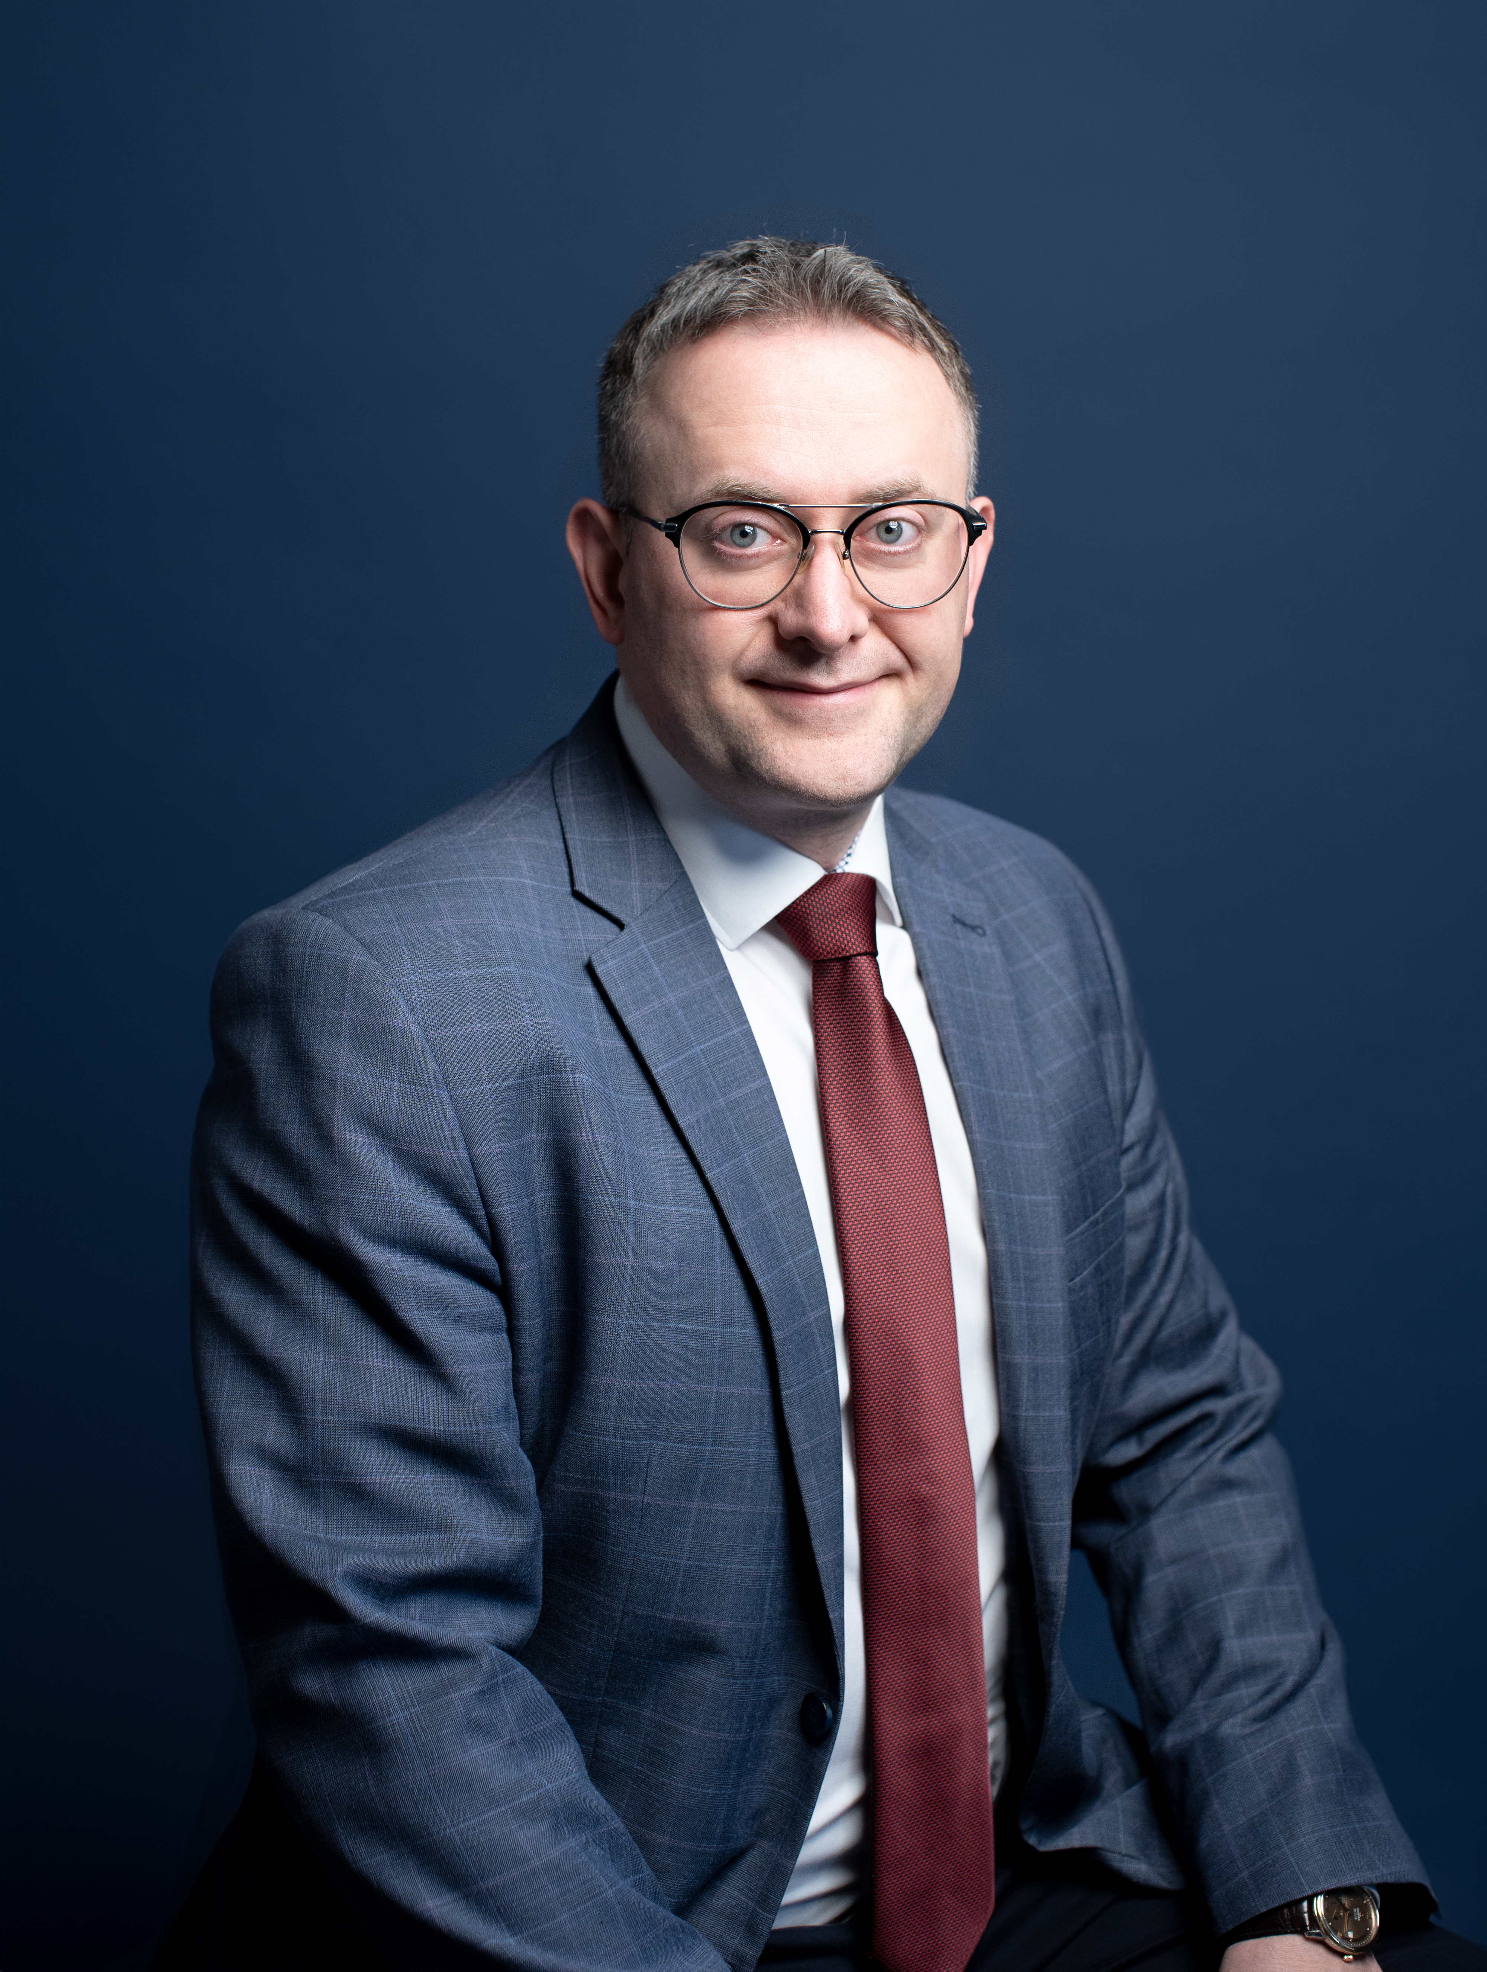
Markian Malskyy
Mr. Markian Malskyy is Managing Partner and Head of the West-Ukrainian Branch at ARZINGER, attorney-at-law, Ph.D. hab., Honorary Consul of Austria in Lviv.
He has been Head of Arzinger’s Western Ukrainian Branch in Lviv since 2009. The associates of the branch support numerous large-scale projects. They advise on real estate, construction, information technology, business structuring, representation in litigations, and provide advice and support for public-private partnership projects, etc. In the last 15 years, Markian has been pursuing his professional activities in the field of law, mainly representing the interests of clients in energy, real estate, tax and customs, other legal and arbitration disputes, corporate relations and investments.
In 2019 was the Governor of Lviv region and was named among the top-5 most effective governors of Ukraine of 2019 according to Dilova Stolytsia newspaper.
Markiyan was a partner with Kochański & partners, a Polish law firm, professor at Warsaw University, where he taught international arbitration and private law in English and Polish.

Slide 51
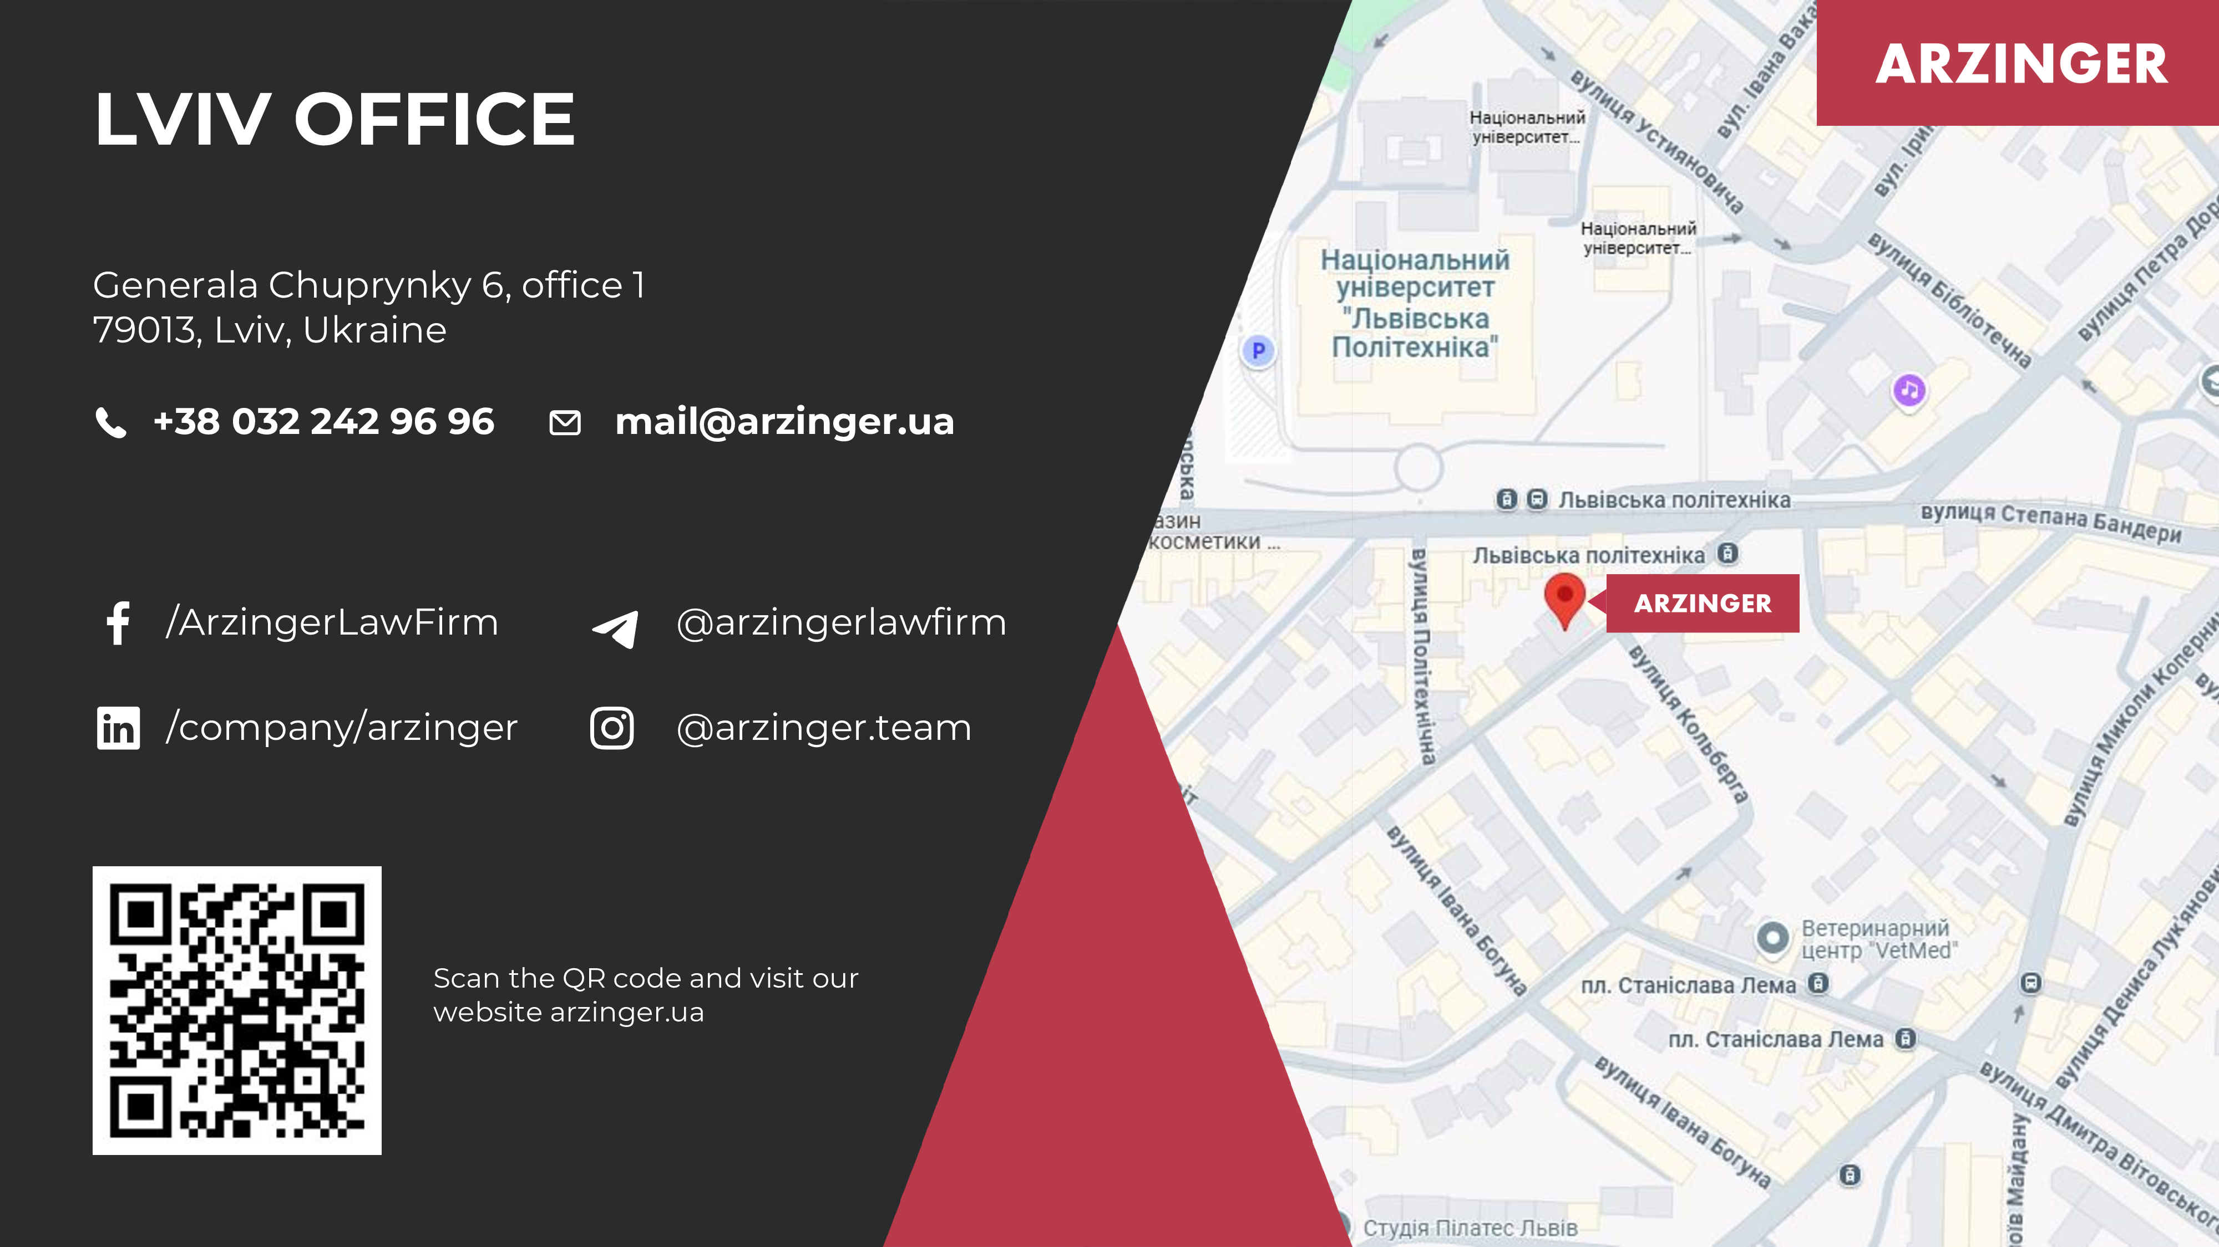
WESTERN UKRAINIAN BRANCH

Slide 52
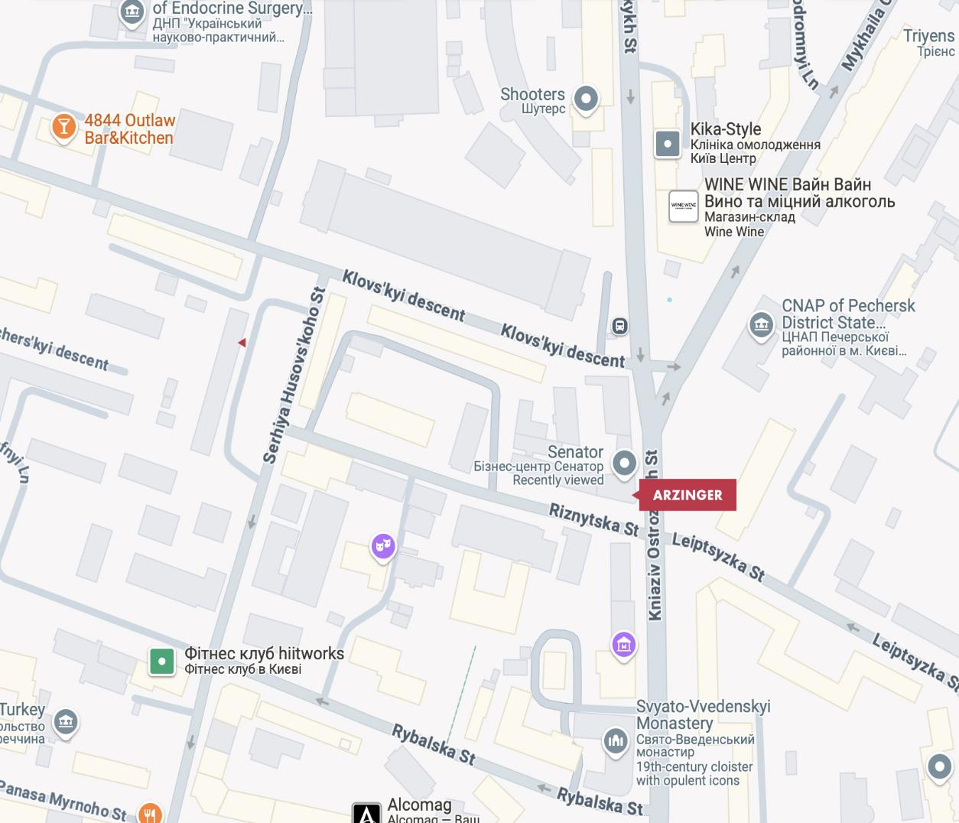
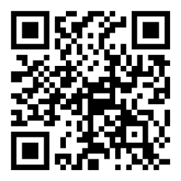
MAIN OFFICE
Business-center
"Senator"
32/2 Knyaziv Ostrozkykh St., 10th floor, 01010, Kyiv, Ukraine
+38 044 390 55 33
mail@arzinger.ua
/ArzingerLawFirm
@arzingerlawfirm
/company/arzinger
@arzinger.team
Scan the QR code and visit our website arzinger.ua

